Slide 1
Overview of Computer Architecture
Amit Amritkar

Slide 2
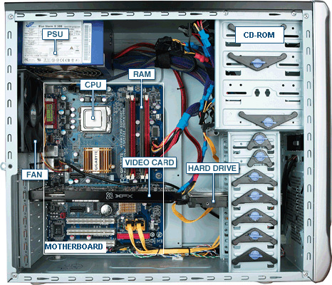
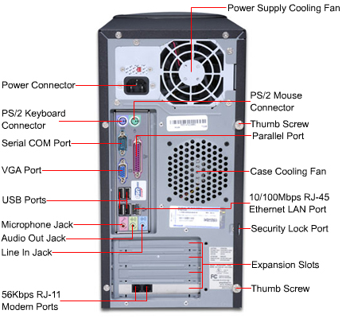
Components of a workstation
http://richweb.allpar.net/computerfiles/E400-T3265-diagram-b-L.jpg
http://1.bp.blogspot.com/-AOq_7ikmzZM/TWfQeO5ht3I/AAAAAAAAABo/UFFNCicYDhY/s1600/3439c_1-pcd-diagram.jpg

Slide 3
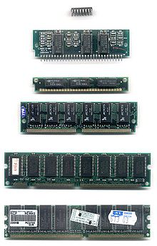
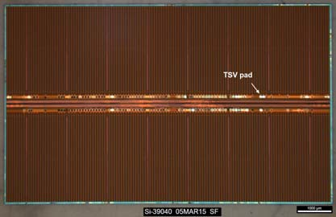
Dynamic Random Access Memory (DRAM)
Common DRAM packages
Samsung 8 Gb, DDR4, 5.8 mm x 9.7 mm die, 20 nm node
http://www2.techinsights.com/l/8892/2015-03-27/kbhjk
https://en.wikipedia.org/wiki/Dynamic_random-access_memory

Slide 4
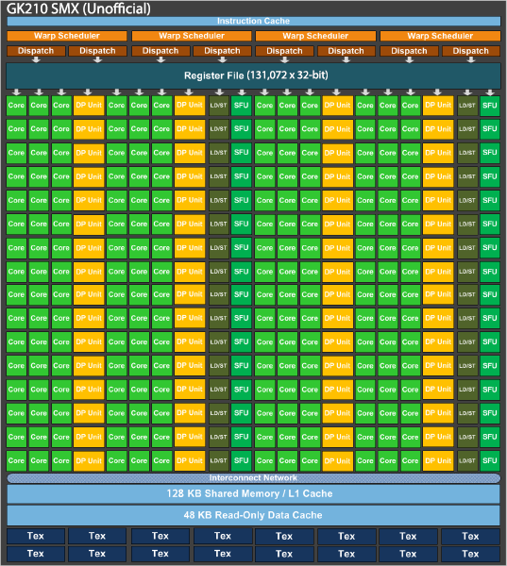
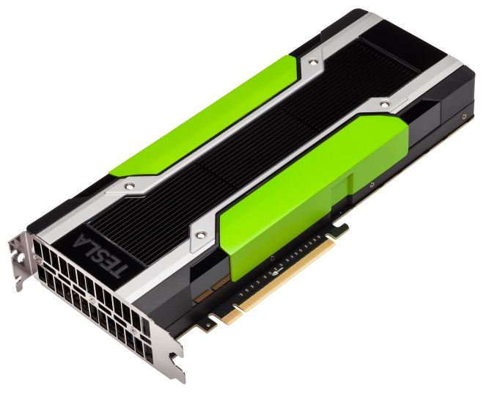
Graphical Processing Unit (GPU)
NVIDIA GPUs
http://www.anandtech.com/show/8729/nvidia-launches-tesla-k80-gk210-gpu

Slide 5
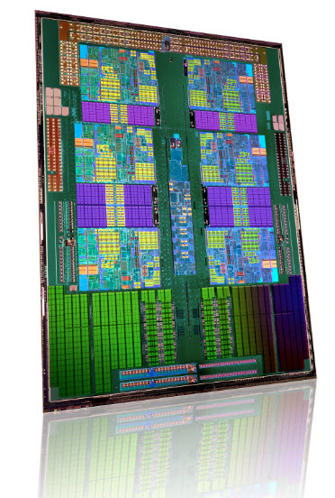
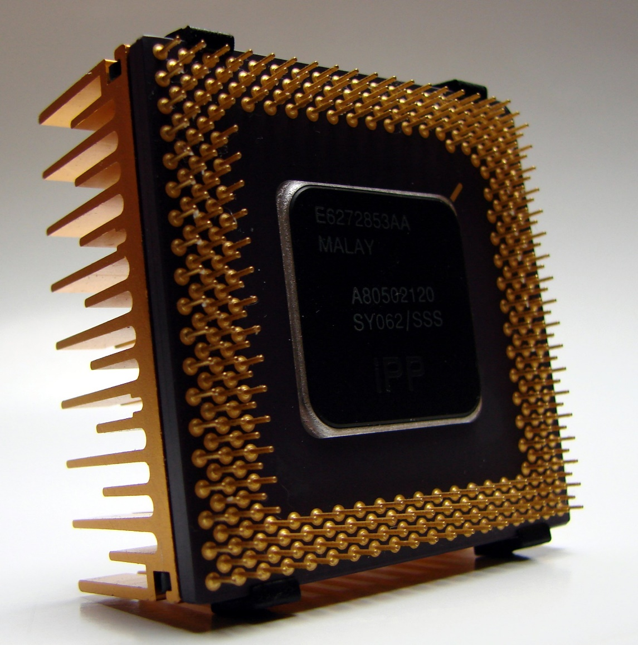
What Does a CPU Look Like?
Notes:
Could not locate original AMD document with this image. However, did find License agreement for AMD advertisers: http://www.amd.com/us/Documents/RevisedTMAgreementExecutionversion.pdf

Slide 6
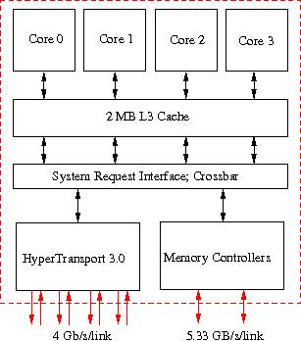
What Does it Mean?
Notes:
Likely TACCs image

Slide 7
Von Neumann Architecture
Instruction decode: determine operation and operands
Get operands from memory
Perform operation
Write results back
Continue with next instruction

Slide 8
Contemporary Architecture
Multiple operations simultaneously "in flight"
Operands can be in memory, cache, register
Results may need to be coordinated with other processing elements
Operations can be performed speculatively

Slide 9
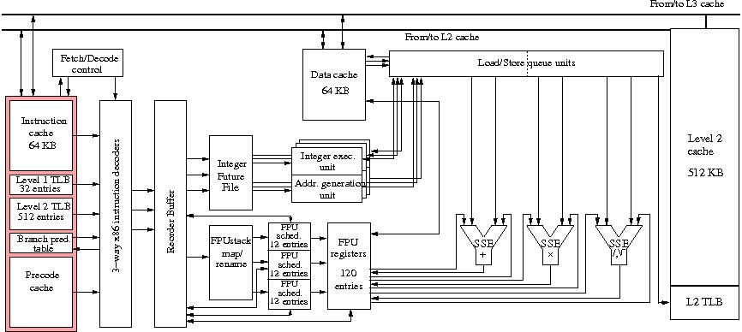
What is in a Core?
Notes:
Likely TACCs image

Slide 10
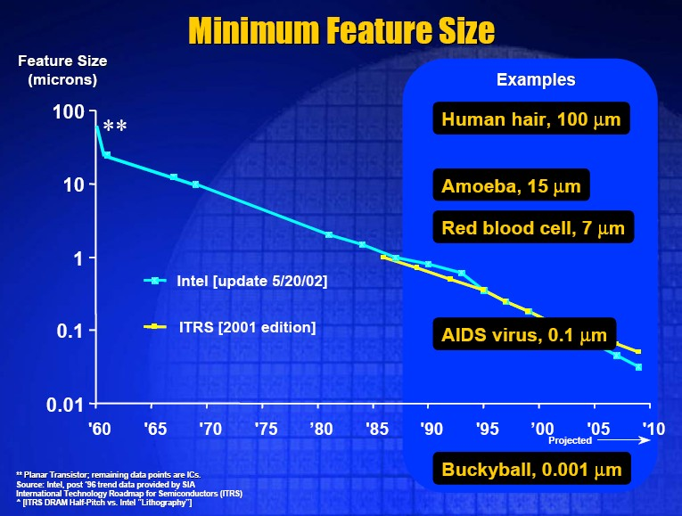
IC Feature sizes in context

Slide 11
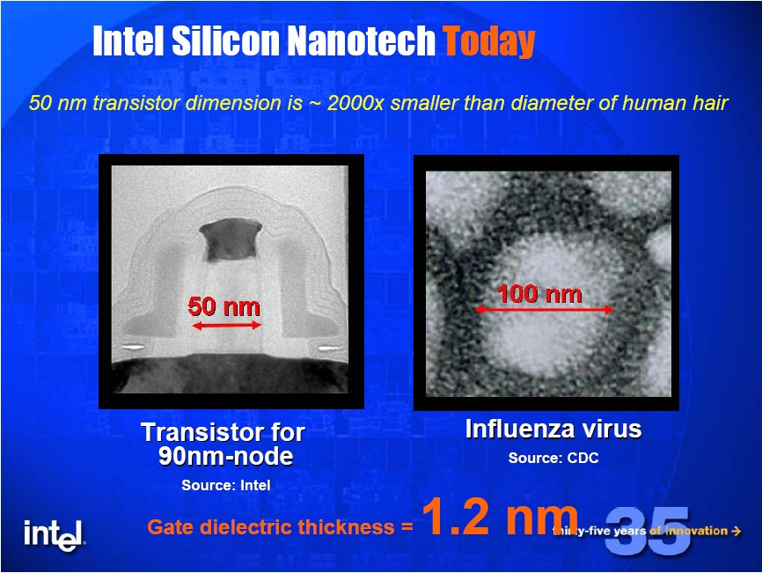

Slide 12
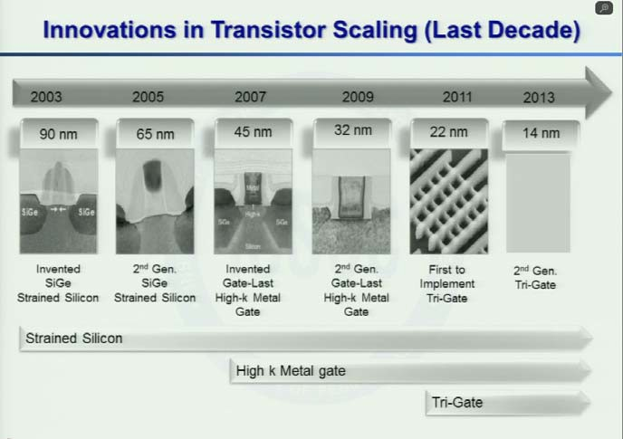
http://isscc.org/media/2012/plenary/David_Perlmutter/SilverlightLoader.html

Slide 13
22 nm comparisons (used for Intel Ivy Bridge CPUs, 2012)
A nail = 20 million nm
A human hair = 90,000nm
Ragweed pollen = 20,000nm
Bacteria = 2,000nm
Intel 22 nm transistor = 22nm
Rhinovirus = 20nm
Silicon atom = 0.24nm

Slide 14
Moore’s Law: 50 Years
Sample of
117 processor chips

Slide 15

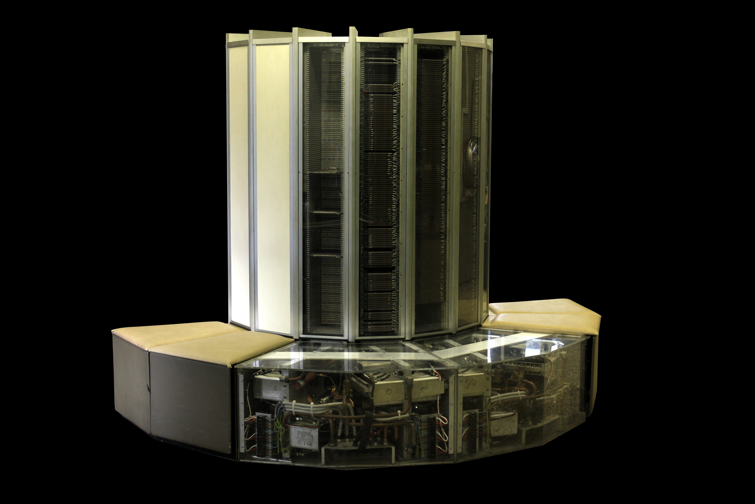
What Moore’s Law Has Meant
1976 Cray 1
250 M Ops/second
~170,000 chips
0.5B transistors
5,000 kg, 115 KW
$9M
80 manufactured
2014 iPhone 6
> 4 B Ops/second
~10 chips
> 3B transistors
120 g, < 5 W
$649
10 million sold in first 3 days

Slide 16
“Moore’s” Law
Feature size halves about every 4.5 years
Transistor count for processor chips doubles about every 21 months
Processor performance doubles about every 20 months
Top500 system performance doubles about every 13 months
That was the “good old days”

Slide 17
Multi-core CPUs
Energy and Heat considerations drove the industry to Multi-core CPUs in order to sustain exponential growth in capability with clock frequencies essentially flat from one generation to the next
Examples of multi-core CPUs
Big cores : 4 cores @3.2GHz
Medium cores : 16 cores @2.4GHz
Small cores : 72 cores @1.5GHz

Slide 18
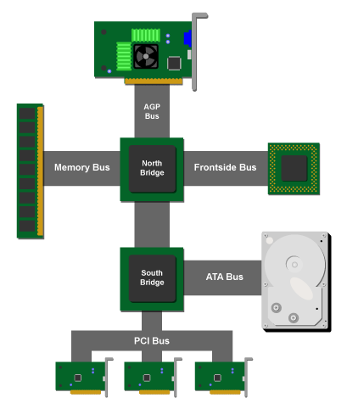
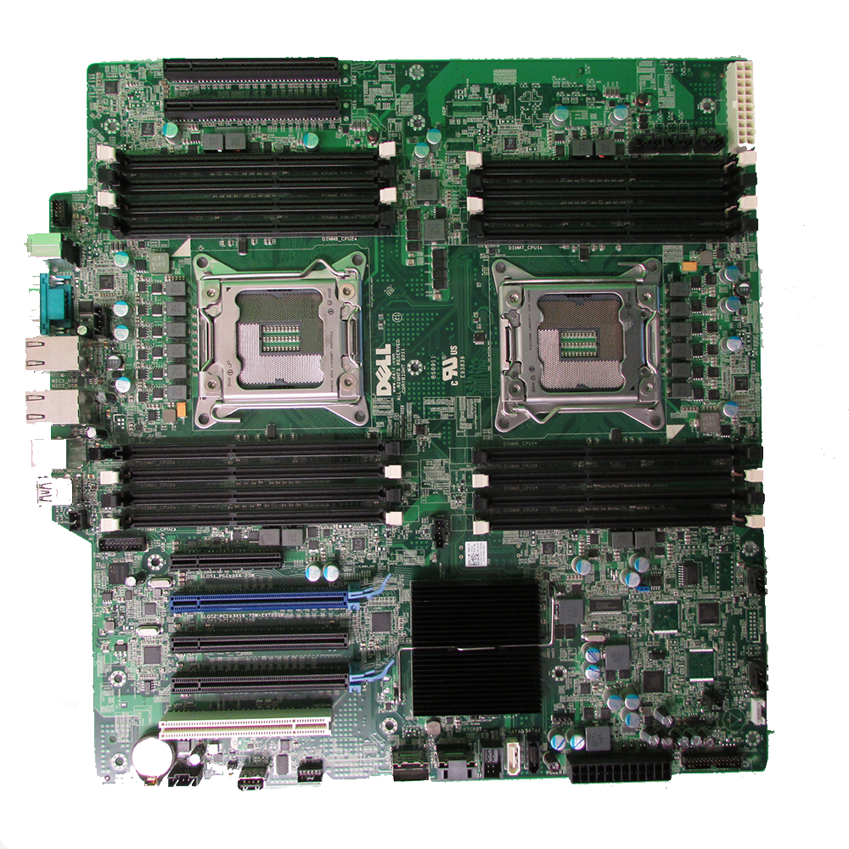
Server/Node Architecture
Sockets
http://mcscom.co.uk/wp-content/uploads/82WXT.jpg
http://2.bp.blogspot.com/-eR5kZqZzvM8/UX5skG1jjVI/AAAAAAAABuE/n06MjoLjcys/s1600/core-logic-southbridge.png

Slide 19
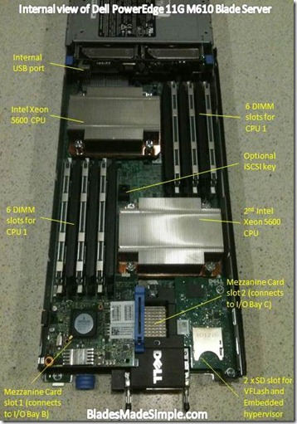
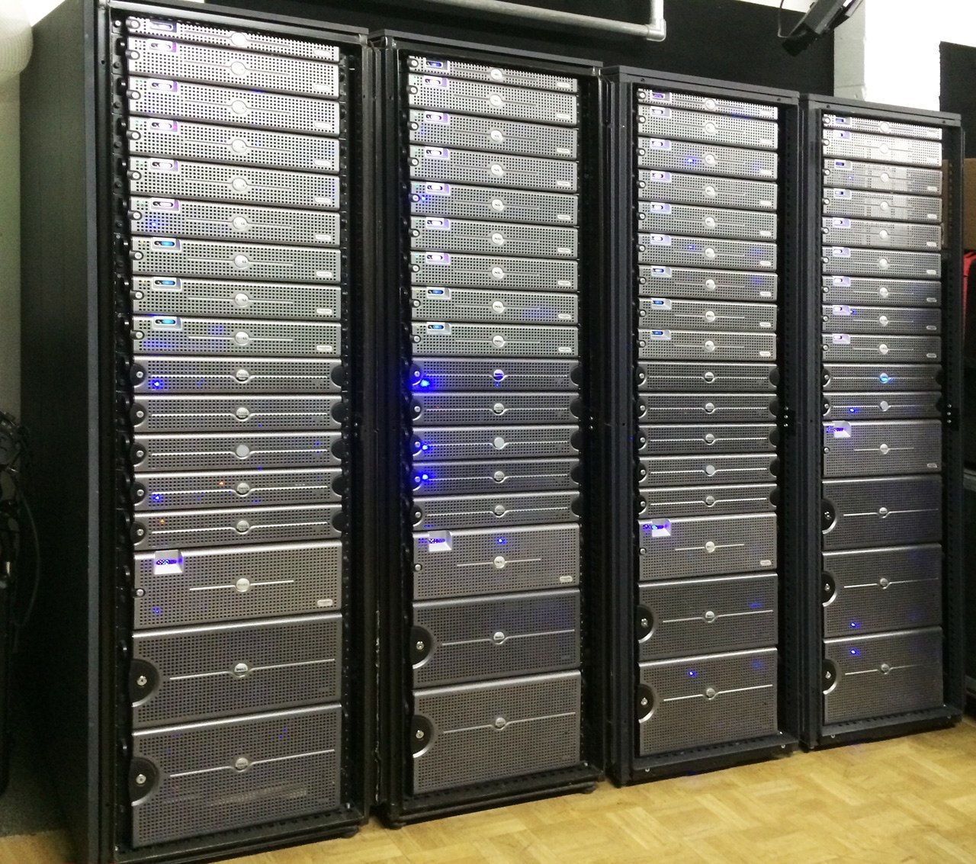
Rack mounted server
http://www.digitalimage4k.com/wp-content/themes/shopperpress/thumbs/DI-Dell-Server-Racks.jpg
http://bladesmadesimple.com/wp-content/uploads/2011/04/Dell-PowerEdge-11G-M610-internal-view-with-labels_thumb.jpg

Slide 20
Conway’s Game of Life
Homework Assignment

Slide 21
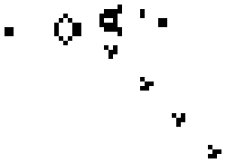
Life
cellular automaton
zero-player game
evolution is determined by its initial state, requiring no further input.
https://en.wikipedia.org/wiki/Conway%27s_Game_of_Life

Slide 22
Rules
The universe of the Game of Life is an infinite two-dimensional orthogonal grid of square cells, each of which is in one of two possible states, alive or dead, or "populated" or "unpopulated".
Every cell interacts with its eight neighbors, which are the cells that are horizontally, vertically, or diagonally adjacent.
At each step in time, the following transitions occur:
Any live cell with fewer than two live neighbors dies, as if caused by under population.
Any live cell with two or three live neighbors lives on to the next generation.
Any live cell with more than three live neighbors dies, as if by overpopulation.
Any dead cell with exactly three live neighbors becomes a live cell, as if by reproduction.
The first generation is created by applying the above rules simultaneously to every cell in the original state—births and deaths occur simultaneously, and the discrete moment at which this happens is sometimes called a tick (in other words, each generation is a pure function of the preceding one).
The rules continue to be applied repeatedly to create further generations.
https://en.wikipedia.org/wiki/Conway%27s_Game_of_Life

Slide 23
Algorithm
Pick a 2D grid of size (n x n)
Randomly initialize the state of each grid cell as either 0 or 1 (dead or alive).
Apply the rules of the game
Continue to iterate for N iterations
Visualize the results
N and n are user provided

